Slide 1
Interaction styles
Muhammad Uzair (19SW45)

Slide 2
Interaction Style
The way a user communicates (interacts) with a computer system to carry out a certain task is defined as an interaction style.
Many different kinds of interaction styles were developed over the years of the still ongoing technological evolution.

Slide 3
Table of contents
Command line interfaces
Menu based interfaces
Point and click interfaces
WIMP Interfaces
3D interfaces
Question answer interfaces
Natural language interfaces

Slide 4
Command line interfaces
They were the first interaction styles to be commonly used
The computer is told to perform a task through certain pre-defined commands.
The commands were based on:
single characters
whole words
abbreviations (cd, mkdir,mv etc)
combinations of the above
Examples : linux terminal, command prompt (cmd), windows PowerShell

Slide 5
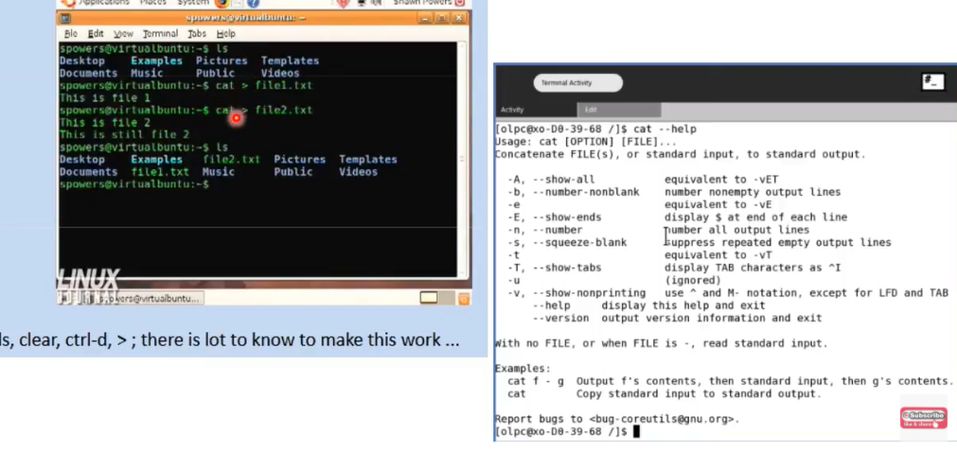
Command Line interfaces

Slide 6
Menu based interfaces
In this kind of interface, the user is presented with a list of options or most time, icons, each of which is mapped to a certain functionality, another screen or a submenu.
The user chooses a option or a series of options from the give list until the desired task is performed.
examples: pop up menu/pull-down menu, icon based, cascading menus.

Slide 7
Advantages
Disadvantages
Meaningful options.
Easy to learn
User doesn’t have to remember anything.
User can perform task based on recognition.
Too many menus irritate users
Consumes too much screen space
Cant go directly to the place we want, have to navigate through multiple menus.

Slide 8
Point and click interfaces
In point and click interfaces, the user is presented with different options, which is selected by placing the cursor on it, and then clicking with the mouse button (usually left button) while the pointer is resting on the particular option.
Examples :
many graphical user interfaces in which the user is presented with a set of buttons which are mapped to different functionalities.
Another example would be hypermedia with hyper links which can be clicked to go from one document to another document.

Slide 9
3D interfaces
In the 3D interfaces, the user provides input to the computer system by moving in a 3-dimentional space.
The 3D space used for providing input can be a physical space or virtual space.
When the real physical space is used for data input, the human interacts with the machine performing actions using an input device that detects the 3D position of the human interaction, among other things. When it is used for data output, the simulated 3D virtual scene is projected onto the real environment through one output device.

Slide 10
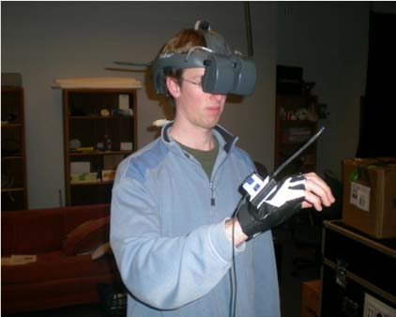

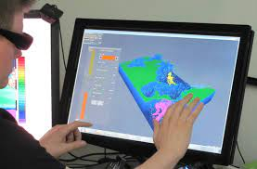
E
X
A
M
P
L
E
S

Slide 11
Question/Answer interfaces
In a question-and-answer interface, the computer displays a question to the user on the display. To interact, the user enters an answer (via a keyboard stroke or a mouse click), and the computer then acts on that input information in a preprogrammed manner, typically by moving to the next question.
Examples : dialogue boxes, install wizards etc.

Slide 12
advantages
disadvantages
Light weight (low memory requirements)
Self explanatory
Fit for novice users
Limited functionality
Requires valid input

Slide 13
Natural Language interfaces
A user interface that allows people to interact using human (natural) language, as opposed to a computer language, command line interface, or graphical user interface.
Natural language interfaces may be designed for understanding either written or spoken text
Examples: Siri, Alexa, Google Assistant or Cortana.

Slide 14
Challenges in natural language interfaces:
Natural language interfaces can be difficult to use effectively due to the unpredictable and ambiguous nature of human speech. Variation in tone and accent can lead to misinterpretation.
A voice interface needs considerable amount of training to get the software to recognize what the user is saying.
High memory requirements
Information overloads (extracting relevant info from a large data set).

Slide 15
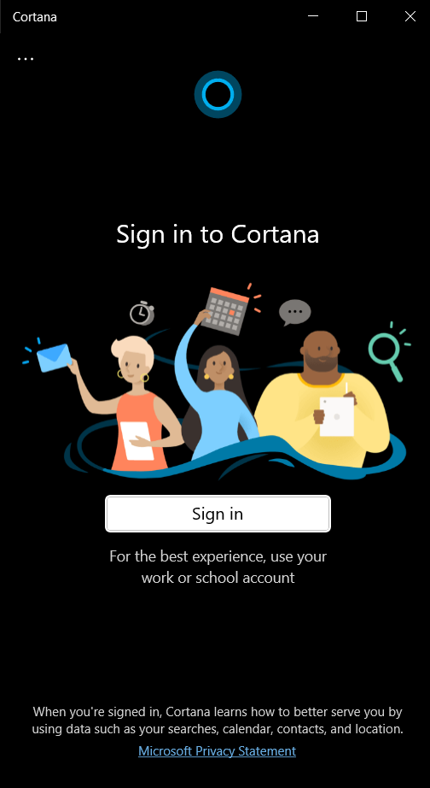
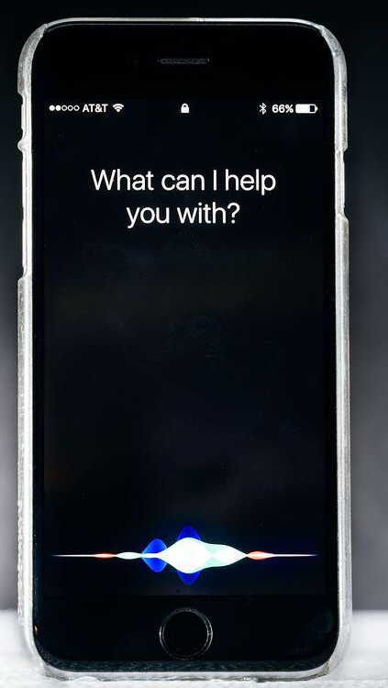
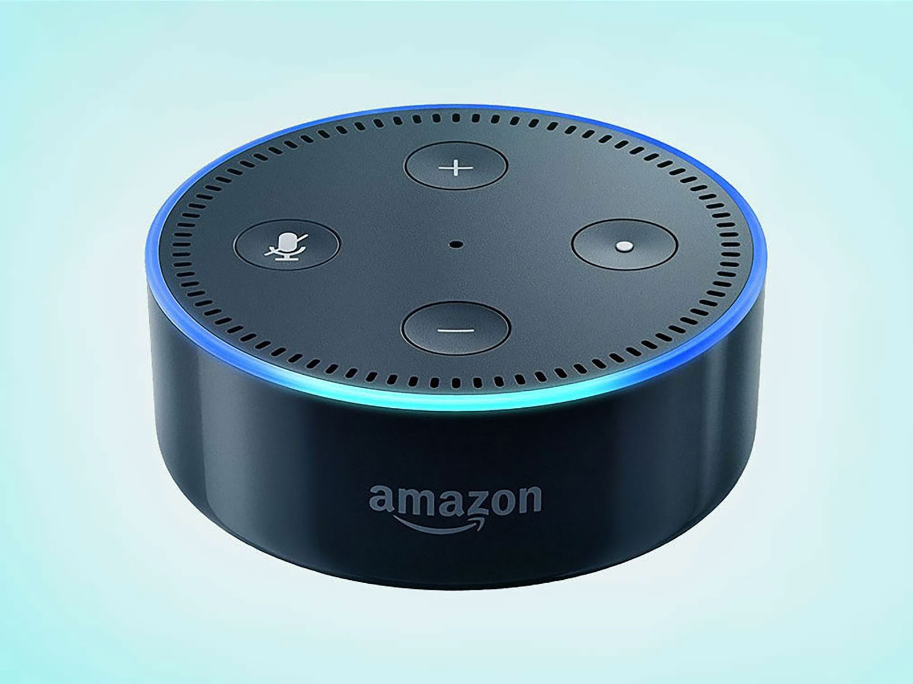
SIRI
Alexa

Slide 16
Thank-you!!

